Slide 1
Scrum Team 2
Sprint 3

Slide 2
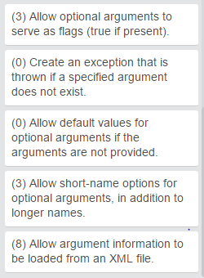
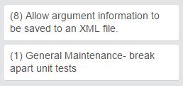
What was pulled?
Total Estimated Points: 23
Total Completed Points: 23

Slide 3
Testing & Code Coverage
Unit Tests
Acceptance Tests
Code Coverage

Slide 4
Program Demos
ShippingCalc.java
WritePizzaArgs.java
PizzaOrderFromXML.java

